Slide 1
Outline of Workshop
First thing: Introduction to Jupyter Notebooks Morning (pre-break):
Stuff
Morning (post-break):
Stuff
Afternoon:
Stuff
Statistical prerequisites: assuming at least one statistics course or some experience statistically analyzing data; basics: Gaussian distribution, p.values, confidence intervals..
Notes on material:
Linear models because they demonstrate concepts (and are useful!). Concepts apply generally.
Combination of theory, software, hands on data analysis
Learn concepts using time series and then generalize to space

Slide 2
Introduction to Jupyter
“Interacting Computing Environment” allowing code, plots, texts, equations, etc. to be created and shared
Requirements:
Python 2.7 or ≥3.3 (even if working in R)
Web application (Jupyter Notebook app in browser)
Language-specific Kernel (R or Python)

Slide 3
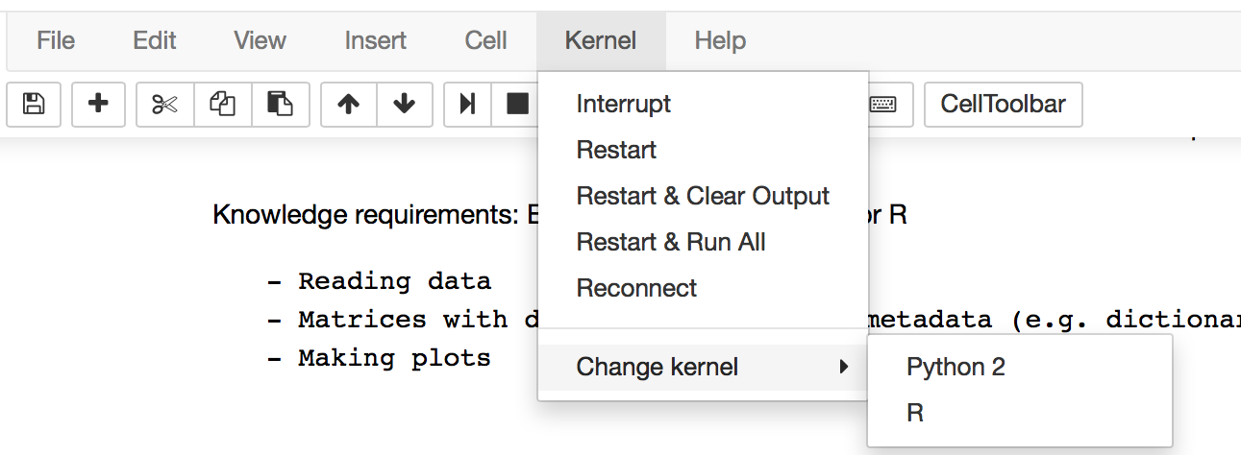
Installing Jupyter Notebooks
Download python2.7 Anaconda distribution from https://www.continuum.io/downloads and follow the on-screen instructions to install Python.
Jupyter is included with the Anaconda python installation! If working in R, you also need to install the R kernel with the following command:
conda install -c r r-essentials
Now you go to the folder containing your Jupyter notebook files in command line and launch Jupyter Notebooks:
jupyter notebook *If in Windows, use the Anaconda prompt, instead of cmd*
If you want to back and forth between Kernels, You can change the kernel between Python and R under the Kernels tab:

Slide 4
Other Requirements
Python
The main packages used in the workshop (e.g. Numpy, Scipy, Matplotlib, Pandas) come pre-installed with your Conda installation. However, you also need to install statsmodels by using the conda install command in terminal:
conda install statsmodels
R
At command prompt, type: install.packages(c(‘nlme’, ‘fields’, ‘geoR’))

Slide 5
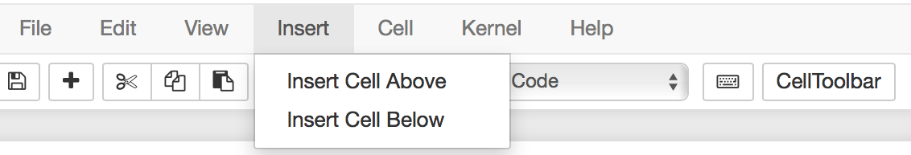
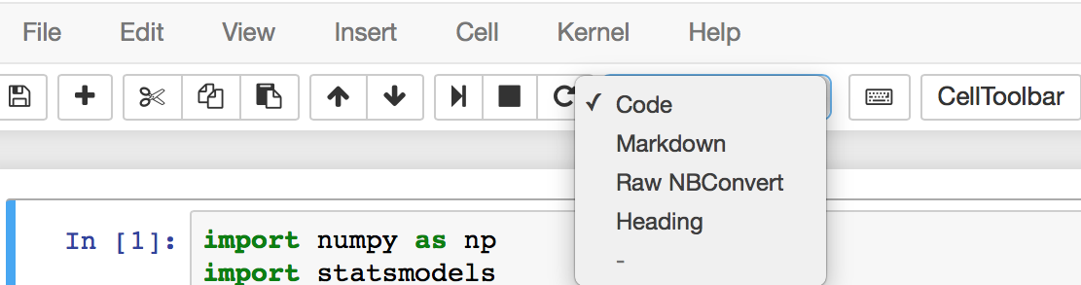
How to use Jupyter Notebooks
Everything goes inside ‘cells’. Create a cell:
Determine cell type:
Markdown for text, headers, equations;
Code for Python or R code that needs to be run (i.e. produces output).

Slide 6
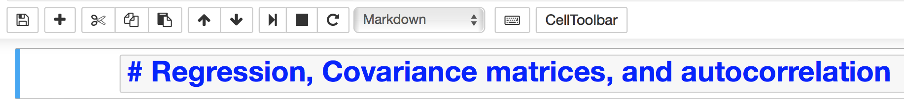
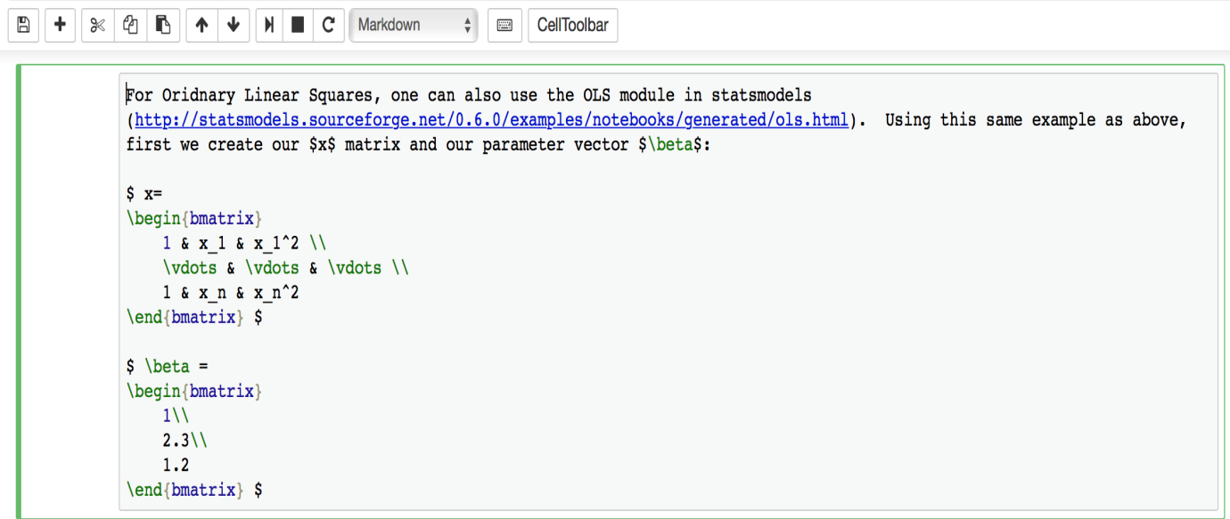
How to use Jupyter Notebooks (cont’d)
Convert Markdown to Header by simply using a # before the text and then run the cell:
Can also use Latex in Markdown:

Slide 7
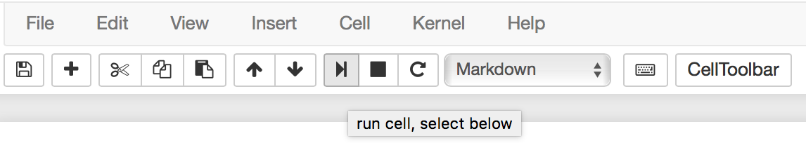
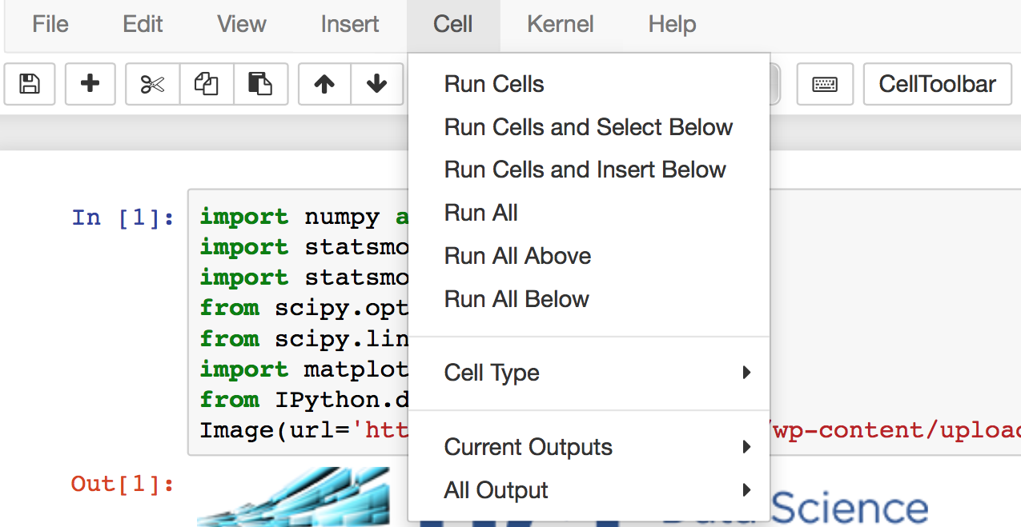
How to use Jupyter Notebooks (cont’d)
You can run each block of Mardown or code and get an output box:
Or run them all together:

Slide 8
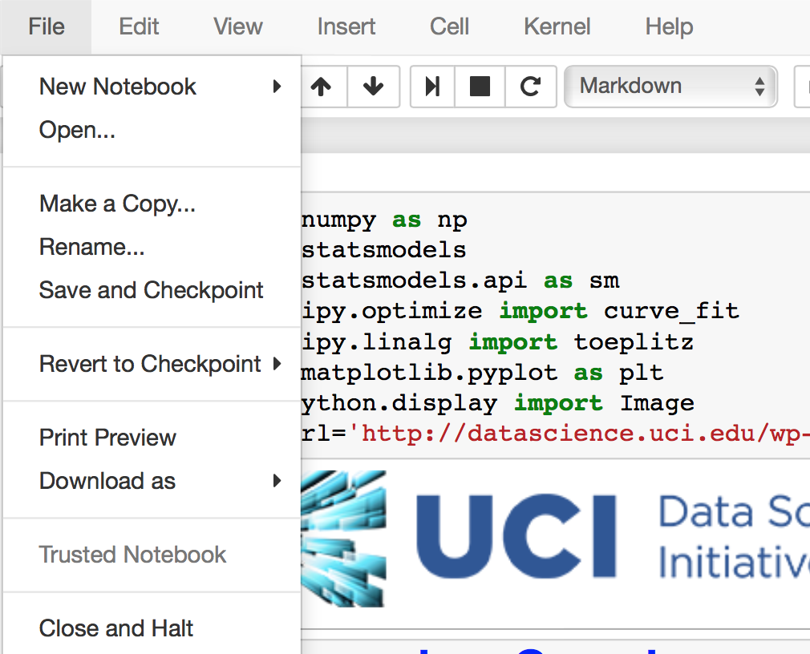
How to use Jupyter Notebooks (cont’d)
Finally, you can save a notebook when you’re done editing:
And close the kernel:
Notes:
Could insert the first SST plot here to make sure everything is working

Slide 9
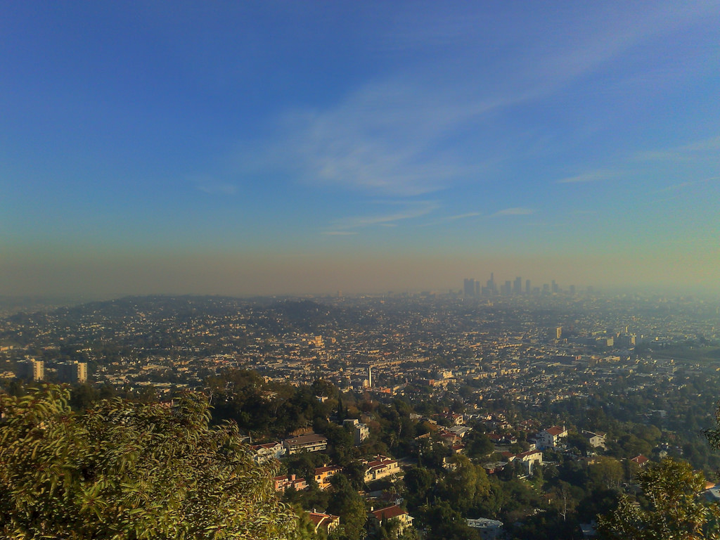







An Introduction to Spatial-Temporal Statistics
UCI Data Science Initiative Short Course Gregory Britten (gbritten@uci.edu), Yara Mohajerani (ymohajer@uci.edu)
Notes:
Workshop has been in the making for a while
Part of larger workshop effort in environmental statistics
Personal research in oceanography, Yara in glaciology, but interested in applied statistics and data science generally applied to environmental science
Not Bayesian at all
Common goals include analysis of trends, dynamics, statistical significance

Slide 10
Is there a statistical trend in observed air quality? Are times of the year systematically worse? What environmental factors contribute to the trend?
Using environmental datasets but concepts apply across disiplines
Notes:
Air quality of primary concern in Southern California
May want to ask these questions of data and determine the statistical strength of the evidence
Measure this field for concentrations which will exhibit particular statistical properties, regional trends, ‘clumpiness’, statistical relation to other variables.
Aligned with goals of applied statistics
We’ll talk about the statistical processes that generates

Slide 11
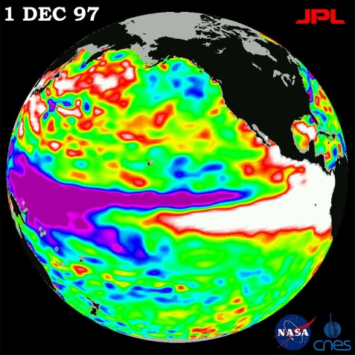
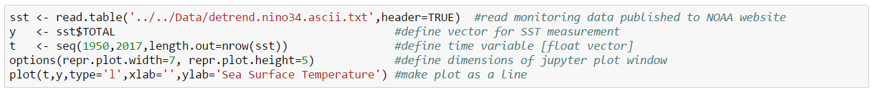
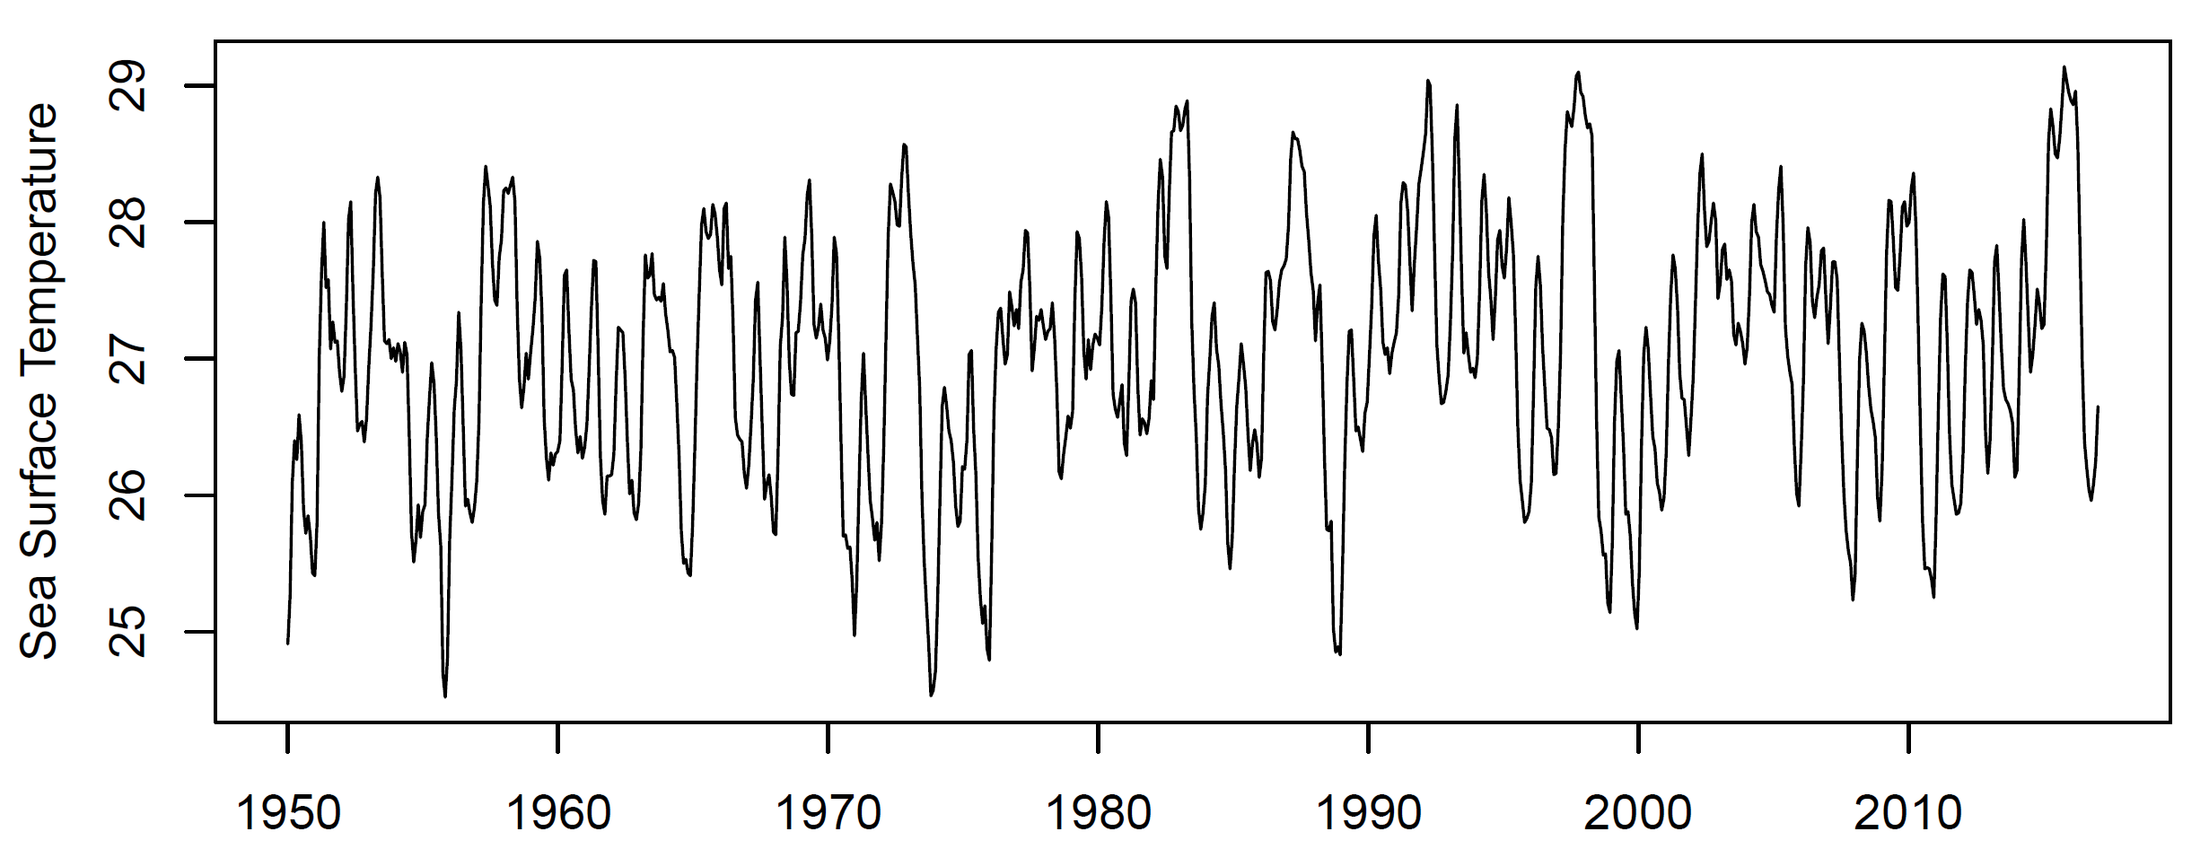
El Nino index: SST off the coast of Central America
Autocorrelation: ‘correlation with self’; measurements closer in time are more correlated (similar in value)
Periodicity: The earth spins and orbits the sun! Seasonal, daily, and other climate cycles are fundamental and seen in many datasets
Sea Surface Temperature
Notes:
Take a look at a representative environmental time series
Clumpiness in time,
Downloaded from NOAA dataset
Much like the ozone case, we might be interested characterizing the regional variability, the clumpiness, the trend, etc.

Slide 12
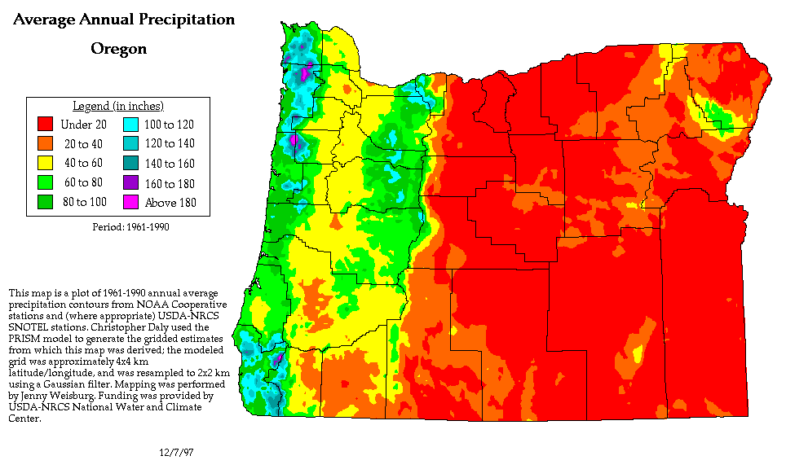
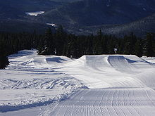
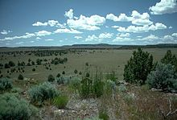

Slide 13
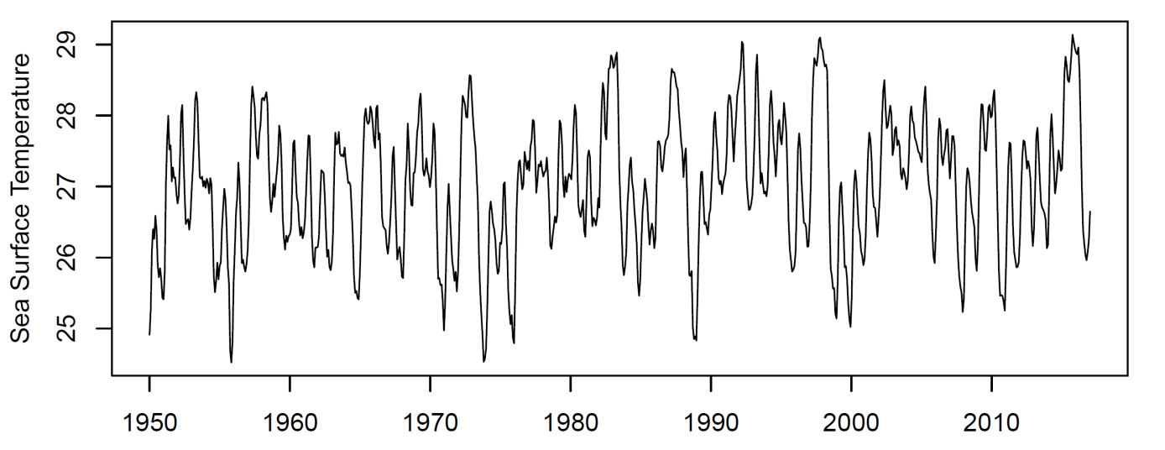
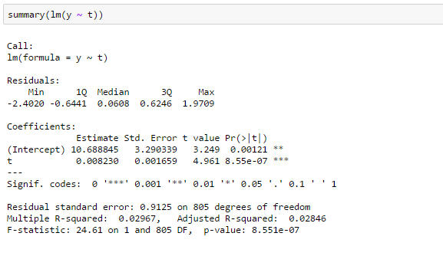
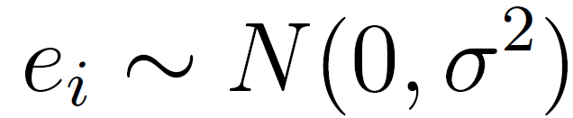
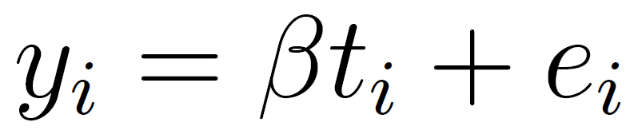
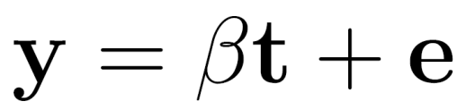
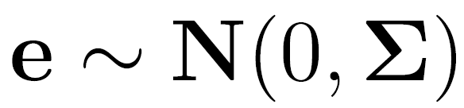
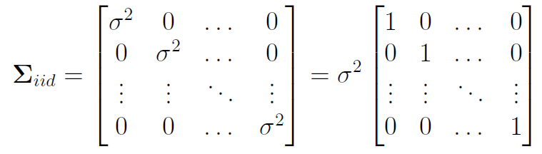
Is there a trend? ..a first attempt
Indicates strong evidence Alert the press, the ocean is warming!

Slide 14
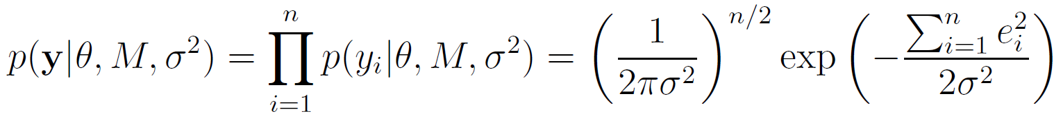
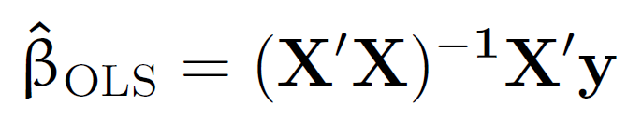
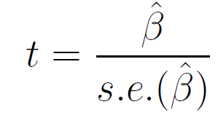
Is there a trend? ..a first attempt
Indicates strong evidence Alert the press, the ocean is warming!

Slide 15
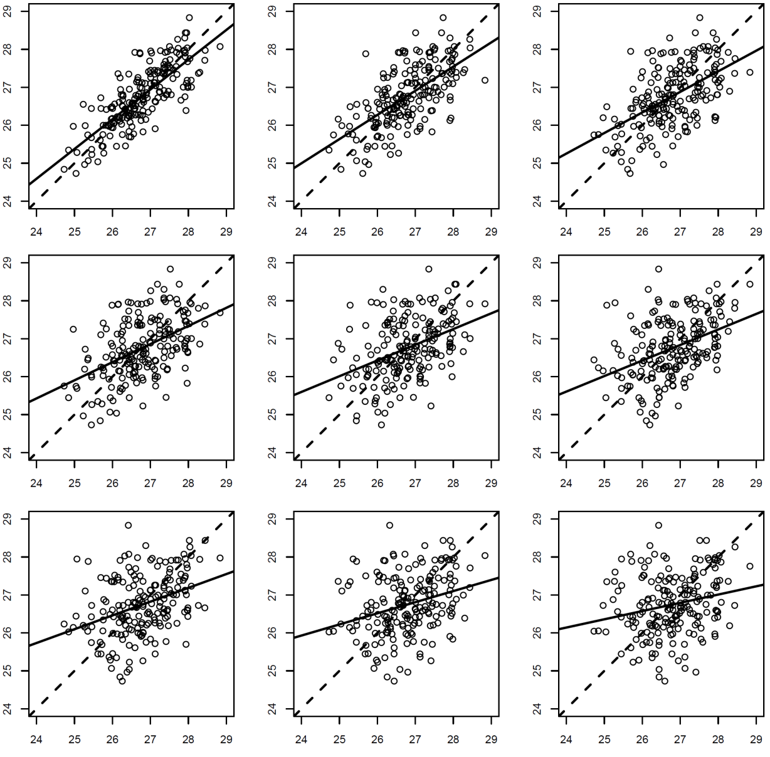

What Generates the Pattern? Key concept: autocorrelation as a function of lag
Places closer to one another are more similar => autocorrelated
Correlation falls away as a function of temporal distance, or lag
‘Autoregressive’ pattern

Slide 16
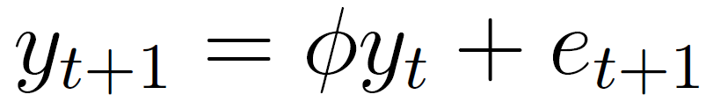
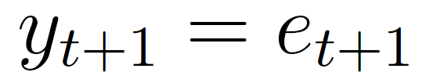
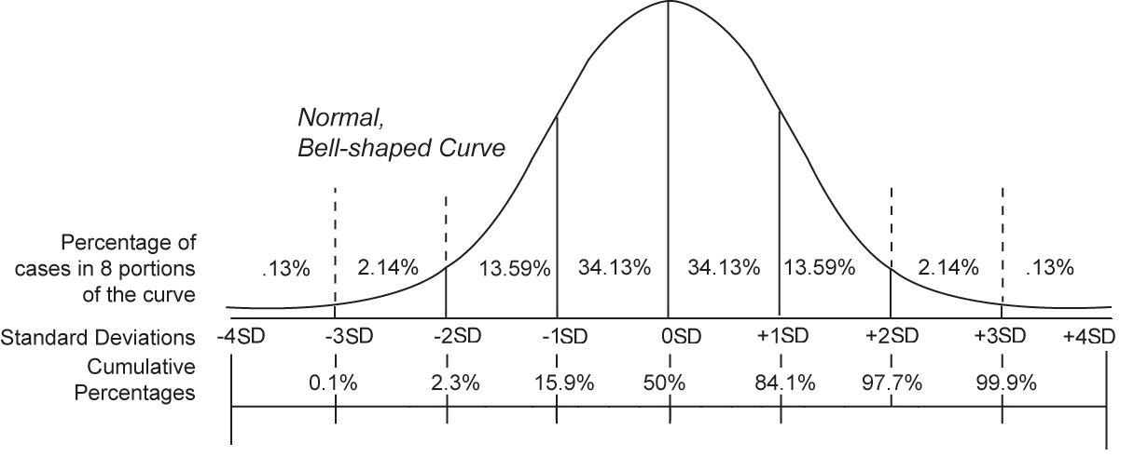
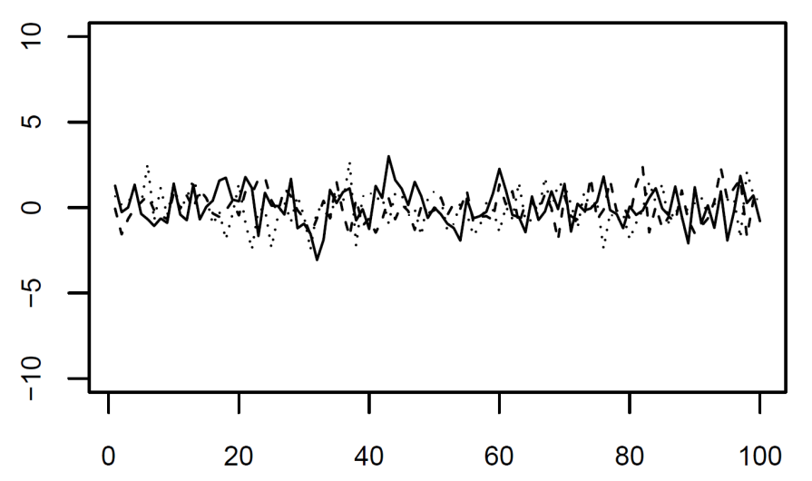
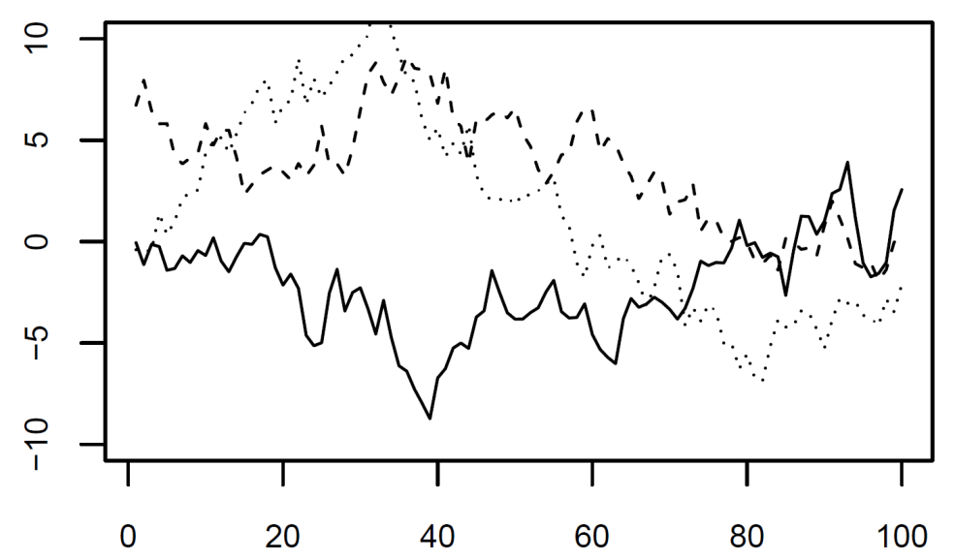
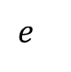
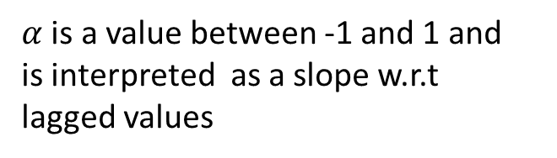
Autoregressive models and the concept of stochastic realization
*autoregressive model
$α$ is a value between -1 and 1 and
is interpreted as a slope w.r.t
lagged values
$$e$$

Slide 17
Autoregressive models and the concept of stochastic realization
*autoregressive model
$α$ is a value between -1 and 1 and
is interpreted as a slope w.r.t
lagged values
$$e$$

Slide 18
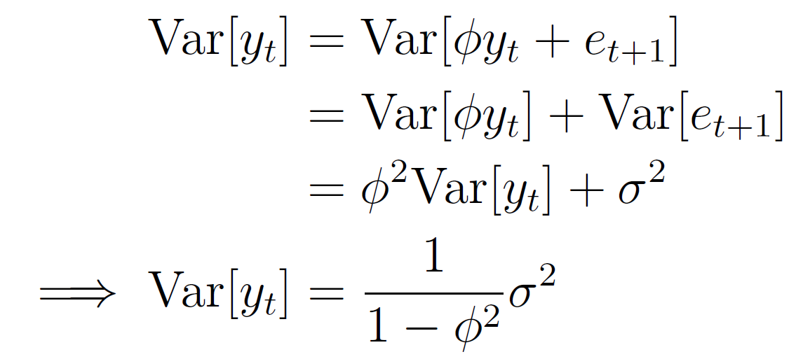
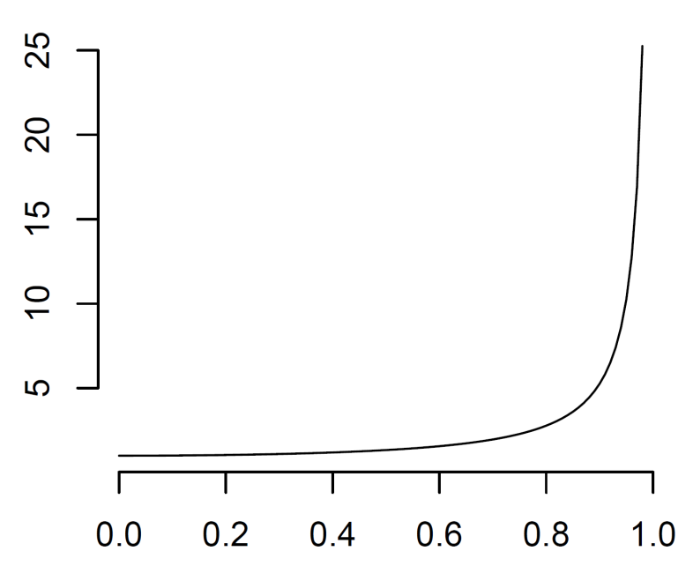
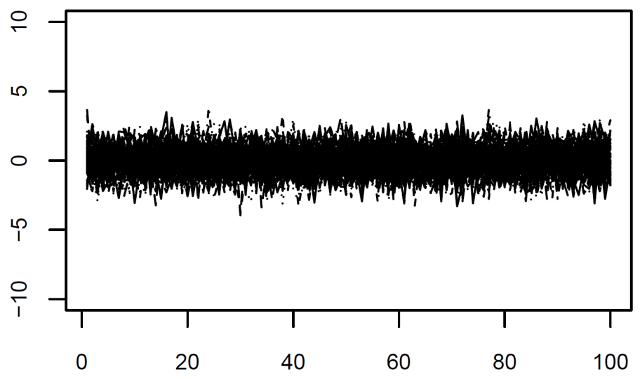
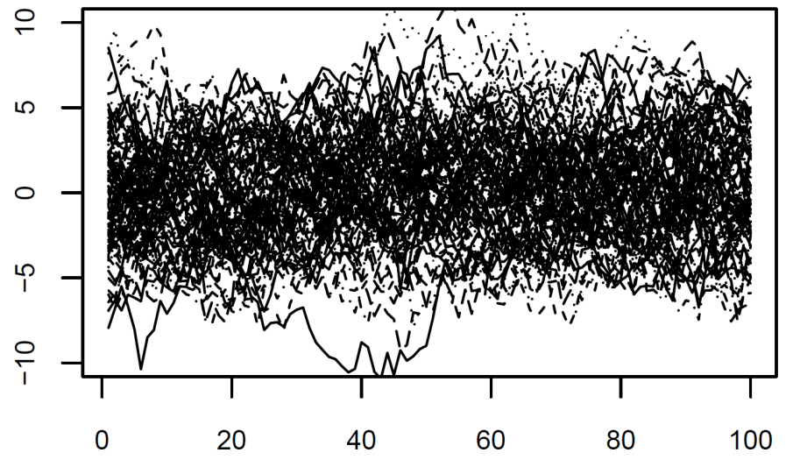
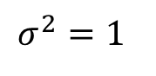
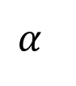
Expected variance of a temporal process increases with autocorrelation
$$σ^{2}=1$$
$$α$$

Slide 19
Exercise: Simulate Different time series with different properties
Code in notebook to simulate autoregressive models

Slide 20
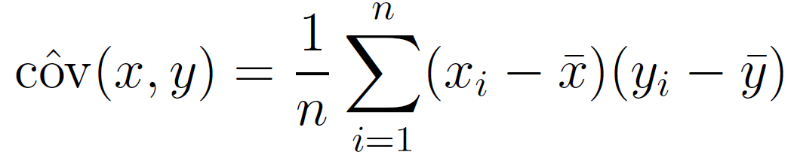
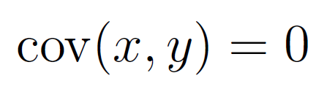
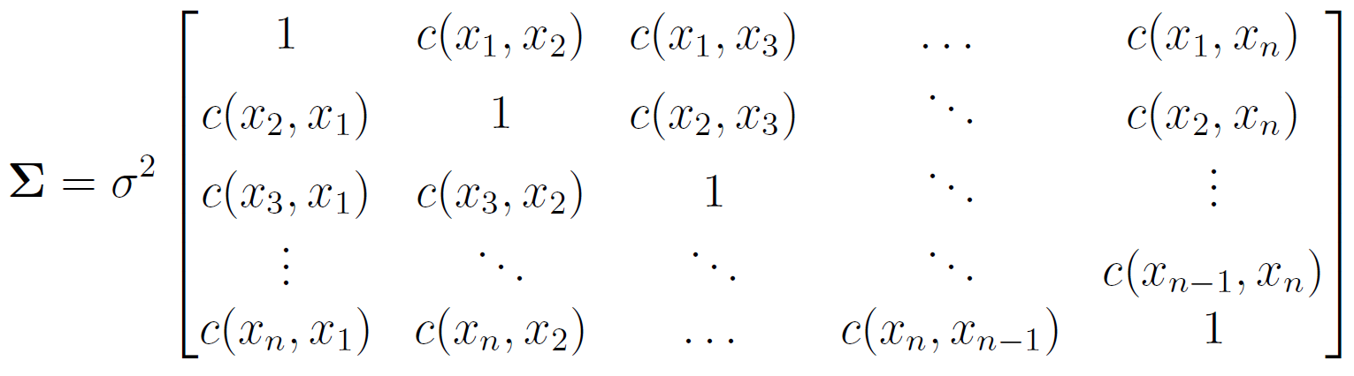
Modeling autocorrelation in stats models
Independence:
Same idea applied to time series; covariance applied to lag:
Now the correlation matrix is filled in with correlations between time intervals:

Slide 21
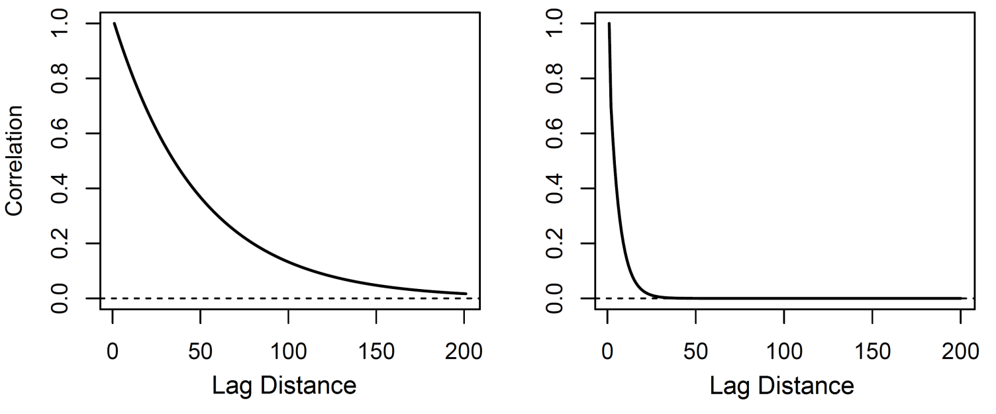
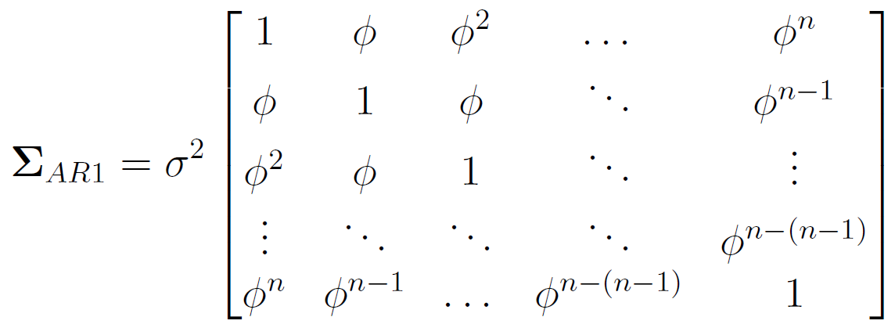
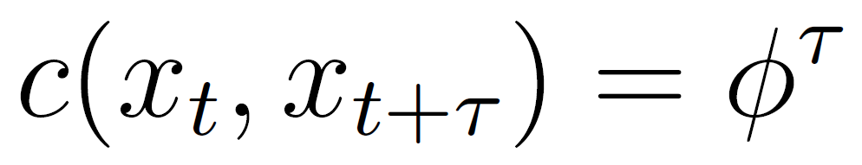
Autocorrelation function ‘fill-in’ the correlation matrix
The autocorrelation function is a curve that provides a value for the expected correlation as a function of lag, which can be in time or space
We’d like to account for spatial correlation when statistically analyzing data because it affects confidence intervals, p.values, posterior probabilities..

Slide 22
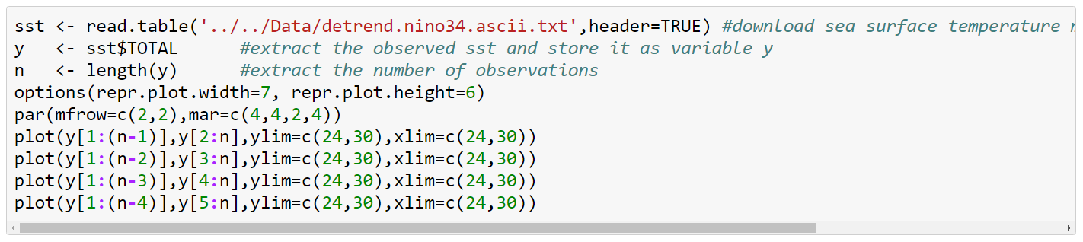
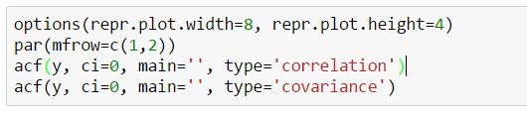
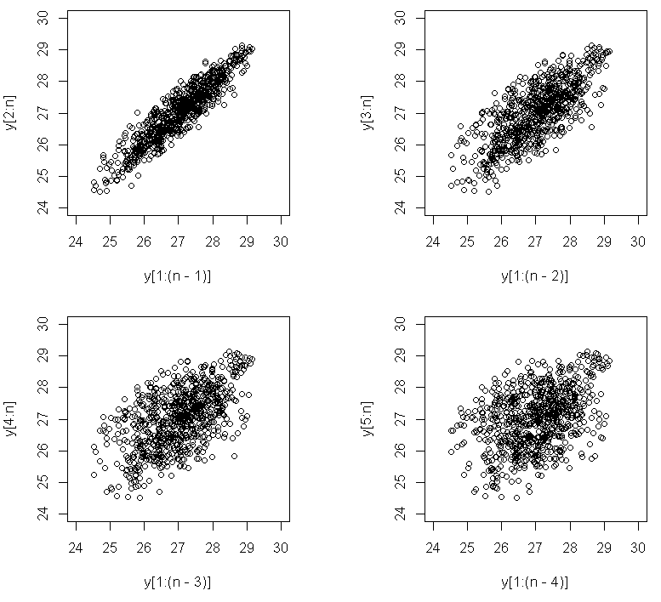
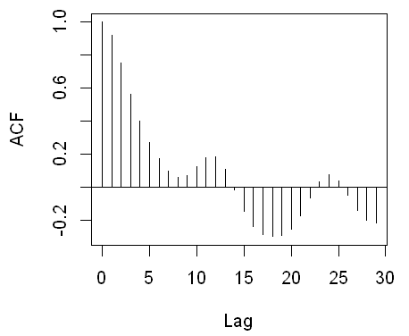
The empirical autocorrelation function

Slide 23
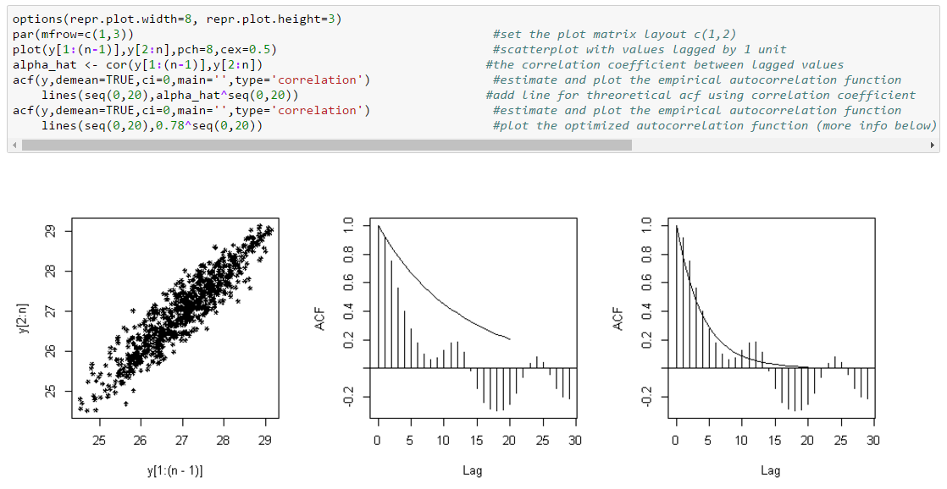
The empirical autocorrelation function for El Nino

Slide 24






The likelihood makes all the difference

Slide 25



Fitting a Model with Temporal Autocorrelation
Much weaker evidence!

Slide 26
BREAK

Slide 27


Dataset #1: Ozone time series at single station
What’s Going on with our Air?
EPA Air Quality Station Data, Orange County

Slide 28

Time series of ozone data

Slide 29

Variables n ≡ number of sample
ozone mean daily ozone
ozone_max
hour_max
Variables n ≡ number of sample
ozone mean daily ozone
ozone_max
hour_max

Slide 30

Simple Trend Analysis

Slide 31



Harmonic regression
Include a periodic covariate with frequency w cycles/time and phase eta
This variable is nonlinear in the parameters. Use the double-angle formula and rewrite the variable as two terms with constant coefficients:
Now we can model any frequency with an arbitrary phase using two terms in a linear regression, with

Slide 32


Harmonic regression
Note: the highest resolvable frequency is that at which observations are resolved
Easy to trick yourself via ‘aliasing’

Slide 33

Time Series Decomposition

Slide 34
Exercise
Decompose other variables into their harmonic, trend, and noise components
Do any variables have a significant trend after correcting for seasonality and autocorrelation?

Slide 35

Time series regression

Slide 36

Standardizing variables for interpretation

Slide 37
Exercise
Fit a model that includes a trend, seasonal term, and one covariate, with an autoregressive correlation matrix
Try adding covariates to the model to see if that changes your first estimates

Slide 38
LUNCH

Slide 39

Time series regression

Slide 40



Simple Model Selection
The ‘best’ model is the one that minimizes the criterion
R and Python readily provide these quantities
More interpretable than p.values, but still no replacement for good judgment

Slide 41

Simple Model Selection
R² always increases with the number of parameters
BIC & AIC penalize more parameters so will only add variables if the increase in likelihood is sufficient
Focuses on model comparison relative to p.value approach

Slide 42
Exercise
Try to find the single best predictor of mean daily ozone concentration, after correcting for seasonality and autocorrelation
Fit multiple regressions and try to find the best model in terms of BIC

Slide 43
Generalizing autocorrelation to space

Slide 44


Temperature and Precipitation
Climatology of Oregon

Slide 45

Generalizing the covariance matrix
d is the distance (or spatial lag) between points i,j
(can be Euclidean, or calculated from a map projection)
We use the exponential correlation numerical reasons, but it closely approximates the autoregressive model

Slide 46



Simulate spatially autocorrelated data

Slide 47

Simulate spatially autocorrelated data
This is the spatial analog to our time series simulations earlier

Slide 48
Exercise
Try generating spatial patterns with different decorrelation parameters and look at the resulting patterns

Slide 49



Spatial interpolation
Often want to make predictions to ‘fill in the map’ based on statistical properties
Krigeing considers a linear model and Normally distribution observations

Slide 50





Given $γ$, the optimal weights are given by an ordinary least squares regression
In general, $γ$ is now known we have to use numerical optimization to find an appropriate value

Slide 51



Just like time series, we fit functional forms to the empirical correlation/variances

Slide 52


Numerical variogram optimization in R
Package properly weights by the number of observations in each bin, so points far away have low influence

Slide 53


Spatial Interpolation

Slide 54
Exercise
Interpolate several variables
Define a new variable, representing the difference in temperature between July and January, and interpolate that variable

Slide 55

Spatial Regression

Slide 56

Spatial Regression

Slide 57




Slide 58



Slide 59




Slide 60





Model Selection

Slide 61
Wrapping Up
What we hope you know and can do:
Understand the statistical properties of spatial and temporal data
How to statistically model spatial-temporal correlation in a stats model
Know basic software for key statistical models
Datasets were relatively small
Two-day workshop next year using Stan
Large area of computational statistics
Hackathon

Slide 62

Derived spatial variables
Construct a new variable

Slide 63
Exercise
Construct a new spatial variable capture the effect of the rain shadow and test the relationship with the data while controlling for spatial autocorrelation

